Slide 1

SMART INDIA HACKATHON 2026
TITLE PAGE
Problem Statement ID – SIH26007
Problem Statement Title- Safe and Efficient Operation of Mine Vehicles in Fog and Low Visibility Conditions in Open Cast Iron Ore Mines
Theme- Smart Automation
PS Category- Hardware
Team ID-
Team Name (Registered on portal)- Radar Rover

Slide 2
IDEA TITLE
Radar Rovers
Proposed Solution
FORESIGHT is an intelligent safety layer for mine vehicles, designed for fog and low-visibility conditions.
How it Works
Multi-Sensors detect vehicles, obstacles & hazards.
AI Detection identifies collision risks in real time.
Vehicle Tracking monitors nearby vehicle movement.
Proximity Zones trigger early danger warnings.
Driver Alerts provide visual & audio warnings.
Central Monitoring tracks overall vehicle safety.
How it Addresses the Problem
DETECT → ANALYSE → WARN → PREVENT
Provides real-time safety awareness when human visibility is limited.
Innovation & Uniqueness
Built for open-cast mining conditions.
Combines AI + Sensors + Tracking.
Enables real-time risk assessment.
Creates a 360° safety zone around vehicles.

Slide 3
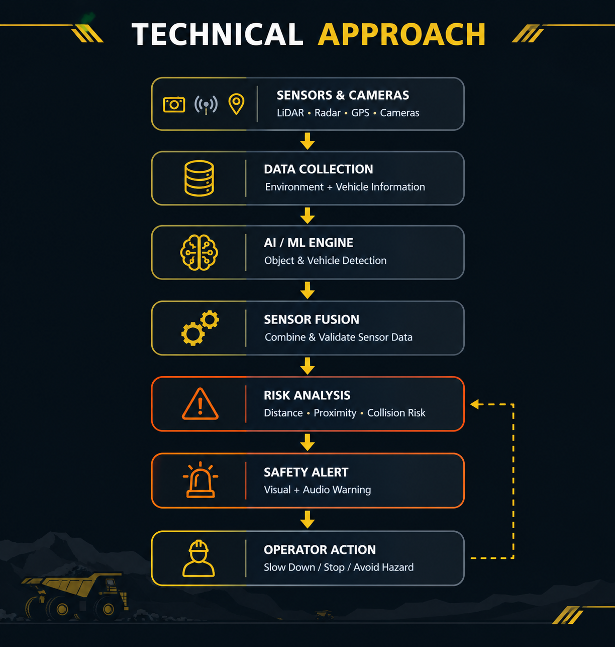
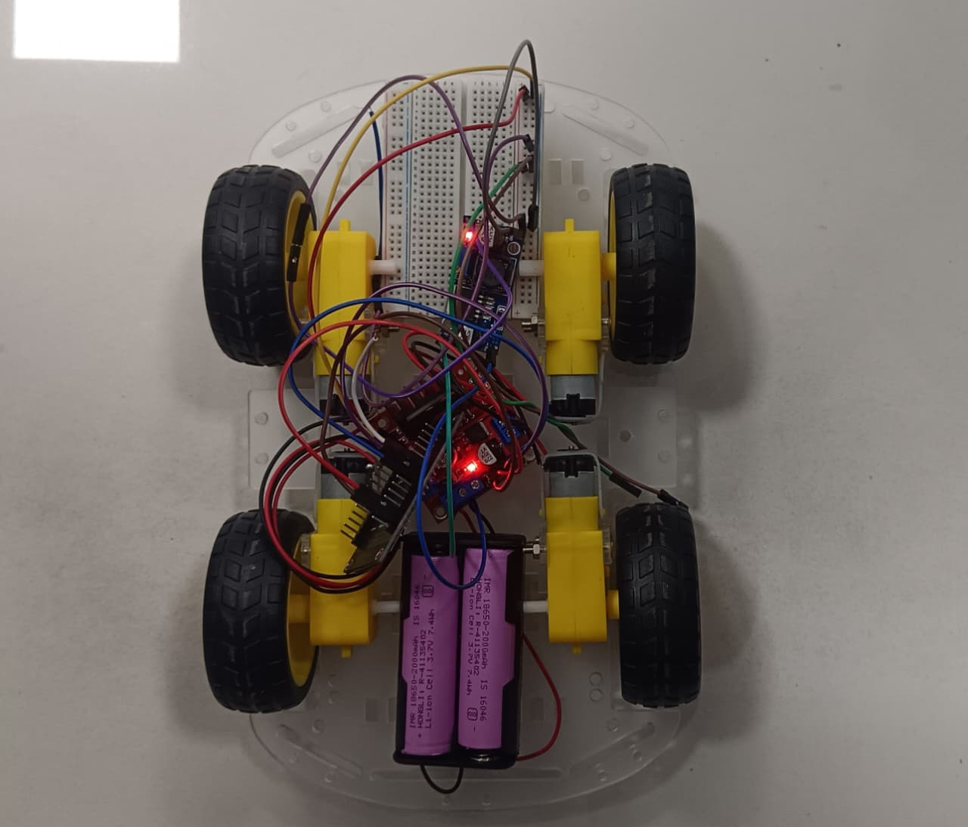
TECHNICAL APPROACH
Radar Rovers
AI/ML + Computer Vision
LiDAR / Radar + Cameras
GPS/DGPS Tracking
Sensor Fusion
Real-time Risk Analysis
Audio + Visual Alerts
Sensors → AI → Risk Detection → Alert

Slide 4
FEASIBILITY AND VIABILITY
Radar Rovers
Feasible because:
Uses available sensors & computing hardware.
Edge processing enables quick alerts.
Modular and upgradeable design.
Challenges → Solutions
Fog/Dust → Sensor Fusion
False alerts → AI Filtering
Harsh conditions → Rugged Hardware
Network issues → Local Processing

Slide 5
IMPACT AND BENEFITS
Radar Rovers
🛡️ Improved mine safety
🚛 Safer vehicle movement
⚠️ Early collision warnings
👁️ Better operator awareness
📊 Real-time monitoring
💰 Reduced accident-related losses
FORESIGHT: Detect Earlier. Warn Faster. Operate Safer.

Slide 6
RESEARCH AND REFERENCES
Radar Rovers
Smart India Hackathon 2026 — SIH26007
NMDC mining operations & safety research
AI-based object detection
LiDAR/Radar obstacle detection
GPS/DGPS vehicle tracking
Sensor fusion & collision avoidance
References:
Smart India Hackathon
NMDC

Slide 7
IMPORTANT INSTRUCTIONS
Please ensure below pointers are met while submitting the Idea PPT:
Kindly keep the maximum slides limit up to six (6). ( Including the title slide)
Try to avoid paragraphs and post your idea in points /diagrams / Infographics /pictures
Keep your explanation precise and easy to understand
Idea should be unique and novel.
You can only use provided template for making the PPT without changing the idea details pointers (mentioned in previous slides).
You need to save the file in PDF and upload the same on portal. No PPT, Word Doc or any other format will be supported.
Note - You can delete this slide (Important Pointers) when you upload the details of your idea on SIH portal.

